Slide 1
Structure Programming
ICT-1105
Information and Communication Technology
Lecture-16
Date:

Slide 2
Class contents has given in Google Classroom with code
nhauiw4

Slide 3
Storage Classes

Slide 4
Storage Classes
In C language, each variable has a storage class which is used to define scope and life time of a
variable.
Storage: Any variable declared in a program can be stored either in memory or registers.
Registers are small amount of storage in CPU. The data stored in registers has fast access compared to data stored in memory.

Slide 5
Storage Classes
There are four properties by which storage class of a variable can be recognized. These are scope, default initial value, scope and life.
A variable’s storage class reveals the following things about a variable
(i) Where the variable is stored.
(ii) What is the initial value of the variable if the value of the variable is not specified?
(iii)What is the scope of the variable (To which function or block the variable is available).
(iv) What is the life of particular variable (Up to what extent the variable exists in a program)

Slide 6
Storage Classes
There are four storage classes in C programming.
1 : Automatic Storage class.
2 : Register Storage class.
3 : Static Storage class.
4 : External Storage class.

Slide 7
Automatic Storage Class
To define a variable as automatic storage class, the keyword “auto” is used. By defining a variable as automatic storage class, it is stored in the memory.
The default value of the variable will be garbage value. Scope of the variable is within the block where it is defined and the life of the variable is until the control remains within the block.
Syntax : auto data_type variable_name;
auto int a, b;

Slide 8
Automatic Storage Class
Features of Automatic Storage Class are as follows:
Storage: Memory
Default Initial Value: Garbage Value
Scope: Local to the block in which the variable is defined
Life: Till the control remains within the block in which the variable is defined

Slide 9
Automatic Storage Class
Example:
void main()
{
int detail;
or
auto int detail; //Both are same
}
The keyword auto is not mandatory. Because the default storage class in C is auto.

Slide 10
Automatic Storage Class
Note: A variable declared inside a function without any storage class specification, is by default an automatic variable. Automatic variables can also be called local variables because they are local to a function.

Slide 11
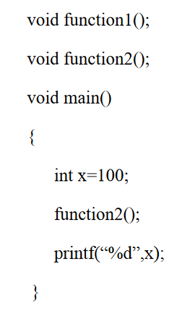
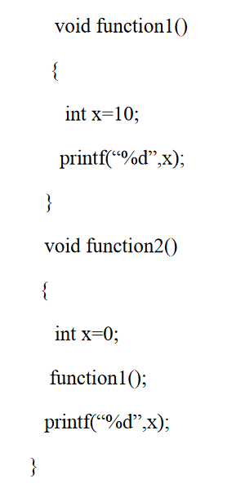
Automatic Storage Class

Slide 12
Register Storage Class
To define a variable as register storage class, the keyword “register” is used. If CPU cannot store the variables in CPU registers, then the variables are assumed as auto and stored in the memory. When a variable is declared as register, it is stored in the CPU registers. The default value of the variable will be garbage value. Scope of the variable within the block where it is defined and the life of the variables is until the control remains within the block.

Slide 13
Register Storage Class
Register variable has faster access than normal variable. Frequently used variables are kept in register. Only few variables can be placed inside register.
NOTE : We can't get the address of register variable
Syntax : register data_type variable_name;
register int i;

Slide 14
Register Storage Class
Features of Register Storage Class are as follows:
Storage: CPU Registers
Default Initial Value: Garbage Value
Scope: Local to the block in which the variable is defined
Life: Till the control remains within the block in which the variable is defined

Slide 15
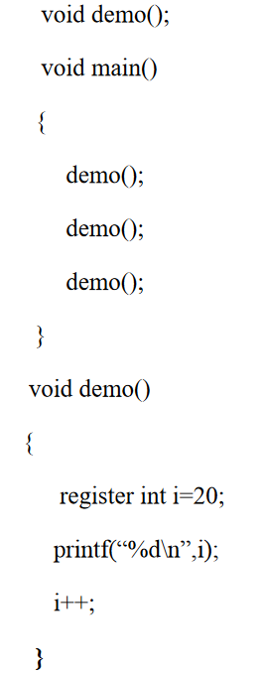
Register Storage Class

Slide 16
Register Storage Class
int main()
{
register int a;
for(a=0;i<50000;i++)
printf(“%d\t”,a);
return 0;
}
In the above program, variable a was used frequently as a loop counter so the variable a is defined as a register variable. Register is a not a command but just a request to the compiler to allocate the memory for the variable into the register. If free registers are available than memory will be allocated in to the registers. And if there are no free registers then memory will be allocated in the RAM only (Storage is in memory i.e. it will act as automatic variable).

Slide 17
Static Storage Class
When a variable is declared as static, it is stored in the memory. The default value of the variable will be zero. Scope of the variable is within the block where it is defined and the life of the variable persists between different function calls.
To define a variable as static storage class, the keyword “static” is used. A static variable can be initialized only once, it cannot be reinitialized.
Syntax : static data_type variable_name;
static int i;

Slide 18
Static Storage Class
Features of Static Storage Class are as follows
Storage: Memory
Default Initial Value: Zero
Scope: Local to the block in which the variable is defined
Life: Value of the variable continues to exist between different function calls

Slide 19
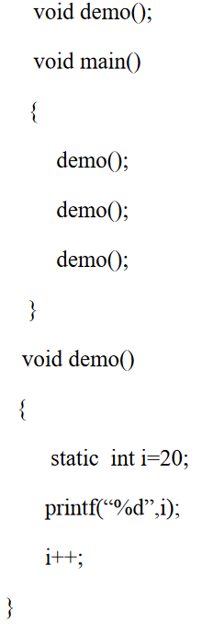
Static Storage Class

Slide 20
External Storage Class
The main difference between automatic and static variables is that static variables are initialized to zero if not initialized but automatic variables contain an unpredictable value (Garbage Value) if not initialized and static variables does not disappear when the function is no longer active , their value persists, i.e. if the control comes back to the same function again the static variables have the same values they had last time.

Slide 21
External Storage Class
When a variable is declared as extern, it is stored in the memory. The default value is initialized to zero. The scope of the variable is global and the life of the variable is until the program execution comes to an end.
To define a variable as external storage class, the keyword “extern” is used. An extern variable is also called as a global variable.
Global variables remain available throughout the entire program. One important thing to remember about global variable is that their values can be changed by any function in the program.
Systax : extern data_type variable_name;
extern int i;

Slide 22
External Storage Class
Storage: Memory
Default Initial Value: Zero
Scope: Global
Life: Till the program’s execution doesn’t come to an end

Slide 23
External Storage Class
External variables differ from automatic, register and static variables in the context of scope, external variables are global on the contrary automatic, register and static variables are local.
External variables are declared outside all functions, therefore are available to all functions that want to use them.

Slide 24
External Storage Class
int number;
void main()
{
number=10;
}
fun1()
{
number=20;
}
fun2()
{
number=30;
}
Here the global variable number is available to all three functions.

Slide 25
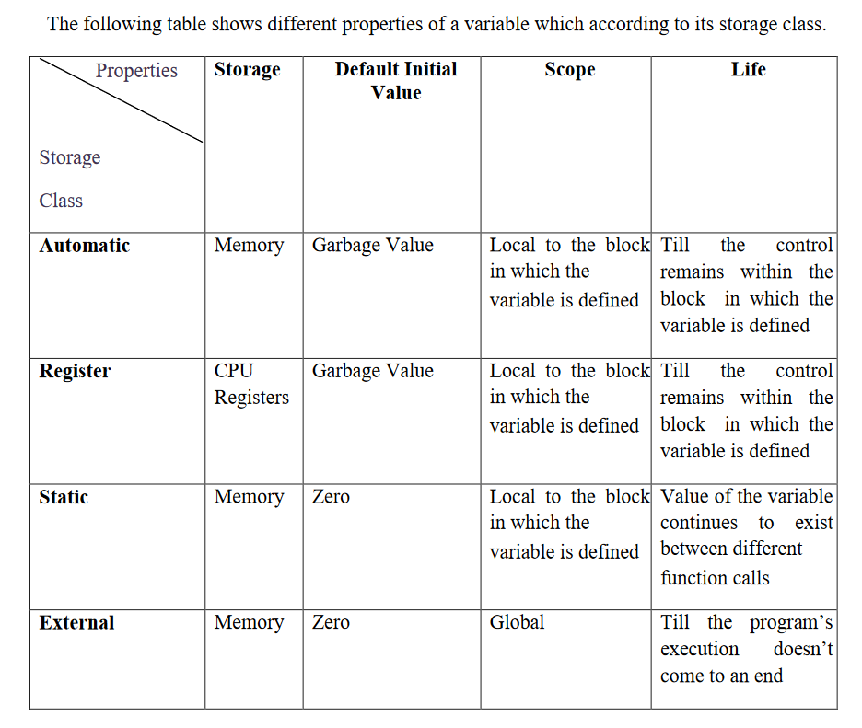
External Storage Class

Slide 26
Recursion

Slide 27
Recursion
When function is called within the same function, it is known as recursion in C. The function which calls the same function, is known as recursive function.
Recursion is often termed as ‘Circular Definition’. Thus recursion is the process of defining something in terms of itself. To implement recursion technique in programming, a function should be capable of calling itself.

Slide 28
Recursion
A function that calls itself, and doesn't perform any task after function call, is know as tail recursion. In tail recursion, we generally call the same function with return statement.

Slide 29
Recursion
Features :
There should be at least one if statement used to terminate recursion.
It does not contain any looping statements.
Advantages :
It is easy to use.
It represents compact programming structures.
Disadvantages :
It is slower than that of looping statements because each time function is called.

Slide 30
Recursion
Example of recursion
recursionfunction()
{
recursionfunction(); //calling self function
}

Slide 31
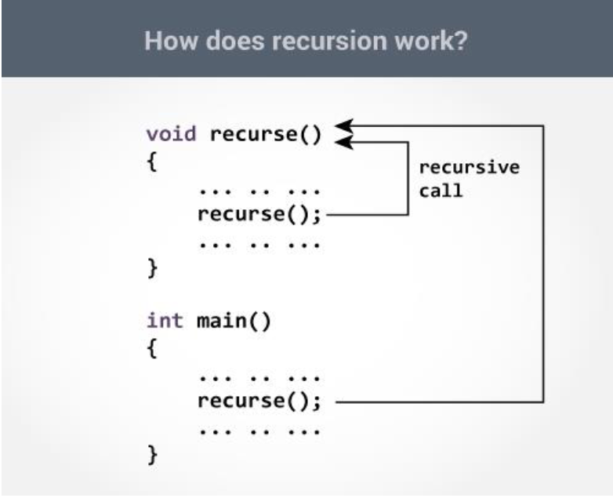
Recursion

Slide 32
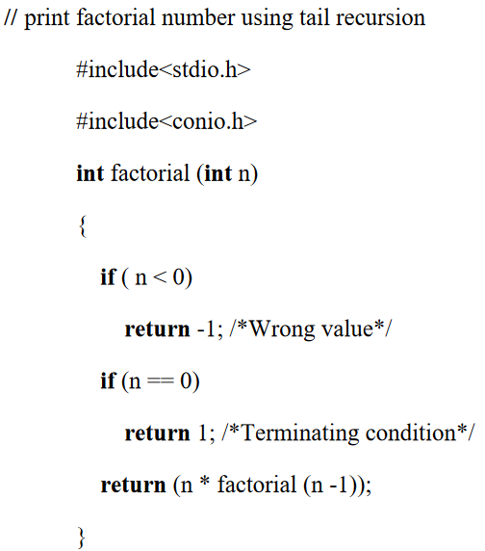

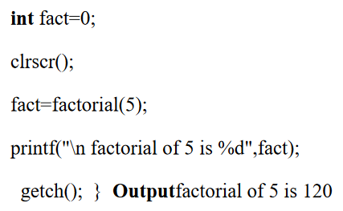
Example of tail recursion in C

Slide 33
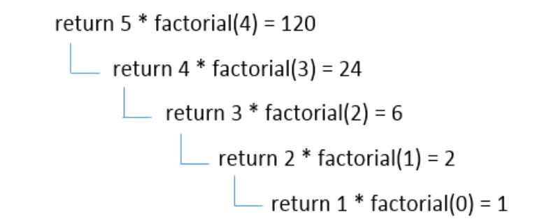
Example of tail recursion in C

Slide 34
Example of recursion
Q1. Write a program using recursion to find the summation of numbers from 1 to n.
#include<stdio.h>
void main()
{
int n,s;
printf(“Enter a number”);
scanf(“%d”,&n);
s=sum(n);
printf(“Sum of numbers from 1 to %d is %d”,n,s);
}

Slide 35
Example of recursion
int sum(int m)
{
int r;
if(m==1)
return (1);
else
r=m+sum(m-1);/*Recursive Call*/
return r;
}

Slide 36
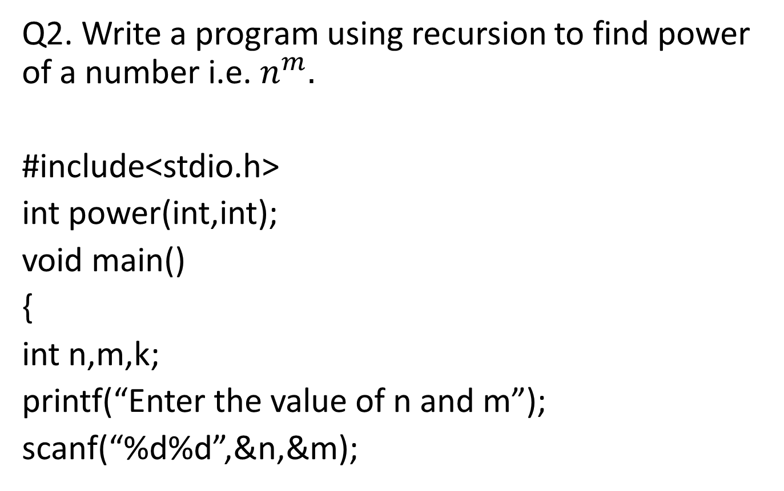
Example of recursion
Q2. Write a program using recursion to find power of a number i.e. $n^{m}.$
#include<stdio.h>
int power(int,int);
void main()
{
int n,m,k;
printf(“Enter the value of n and m”);
scanf(“%d%d”,&n,&m);

Slide 37

Example of recursion
k=power(n,m);
printf(“The value of $n^{m}$for n=%d and m=%d is %d”,n,m,k);
}
int power(int x, int y)
{
if(y==0)
{
return 1;
}
else
{
return(x*power(x,y-1));
}
}

Slide 38
Example of recursion
Q4:Write a program to print Fibonacci Series upto a given number of terms.
Fibonacci series is a sequence of integers in which the first two integers are 1 and from third integer onwards each integer is the sum of previous two integers of the sequence i.e.
1, 1, 2, 3, 5, 8, 13, 21, 34, 55, 89, ……........................
The program which implements the above logic is as follows:

Slide 39
Example of recursion
#include<stdio.h>
int Fibonacci(int);
void main()
{
int term,i;
printf(“Enter the number of terms of Fibonacci Series which is going to be printed”);
scanf(“%d”,&term);
for(i=0;i<term;i++)
{
printf(“%d”,Fibonacci(i));
}
}
int Fibonacci(int x)
{
if(x==0 || x==1)
return 1;
else
return (Fibonacci(x-1) + Fibonacci(x-2));
}

Slide 40
Thank you….

